Slide 1

Petra ten Hove | Rik Bosma | Dirk Thijssen
ADL Webinar - October 26th 2022
Integrated Digital Training Environment for Aircraft Maintenance
Notes:
Short introduction: what is your background? Who is familiar with Learning Eco Systems; ADL architecture, ...? Technical, Training, other?

Slide 2


Intro

Slide 3
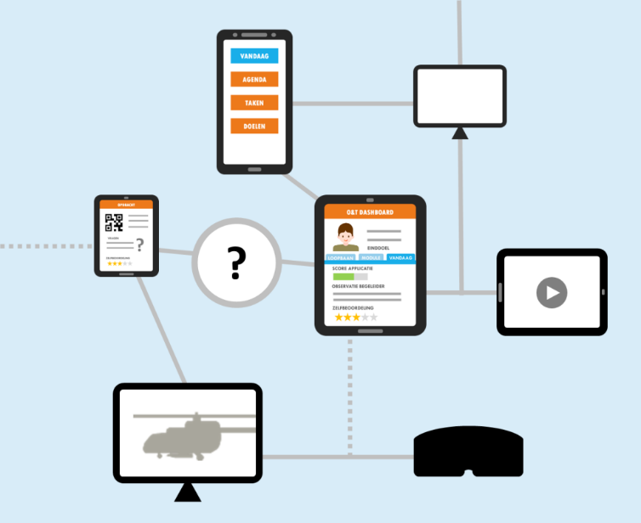
IDTEAM project
  Objective
  Develop and evaluate a technology demonstrator to show the added value of an integrated digital learning environment for aircraft maintenance in the 5th generation Air Force

Slide 4



        LEARNING ECO SYSTEM
Experiences
Logging Learning data
xAPI
Activities
Learner eXperience Platform
LXP
Learning Analytics Platform
LAP
Learning Record Store
LRS
Simulators, Tools & Apps
personal course offer
Analyse Learning data
LA
Notes:
The student learns through experiences and activities, using training resources
The learning process can be tracked by logging these experiences and activities
This is stored in a database
The data is analyzed
And presented
And used to personalize the learning offer
The learning experience platform is the central means to link everything together and present it to the student so that they get the most optimal learning experience.

Slide 5
        LEARNING ECO SYSTEM ARCHITECTURE
Gather and structure learning data
Learning activity
LRS
Competency Framework
xAPI Profile
Analyse
Learner profile
Learner Inference
Learner
Profile
Select learning activities, predict and recommend
Learning eXperience Platform
Recommender
Task Score Predictor
Experience Index
Notes:
With a few small adjustments, the simplified representation of the reference architecture looks like this, this is technically not quite right anymore but in general terms it is okay
Let's put the functional frameworks over this again

Slide 6
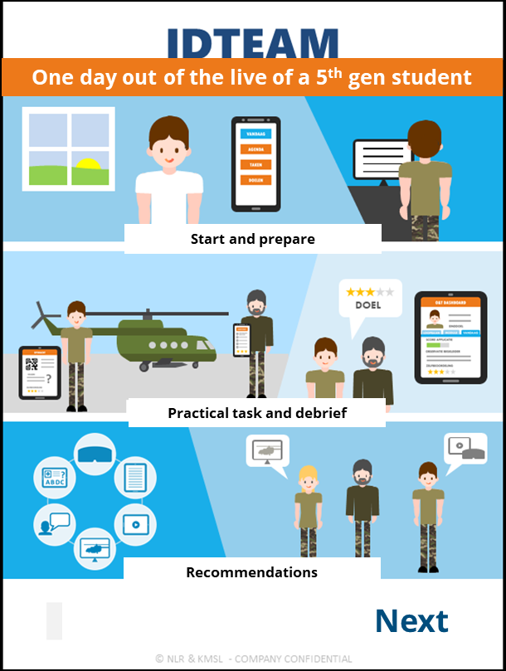
A day out of the live a a 5th gen student
The future scenario describes
what the learning eco system might look like in practice
Notes:
In order define a future-proof learning eco system, it is important to see how this will be used in practice.

Slide 7

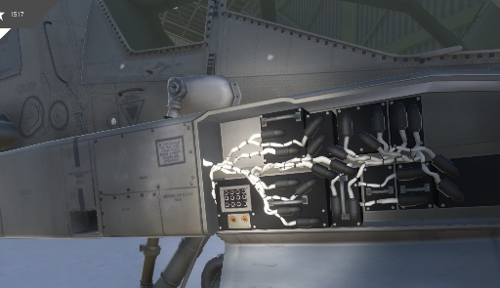
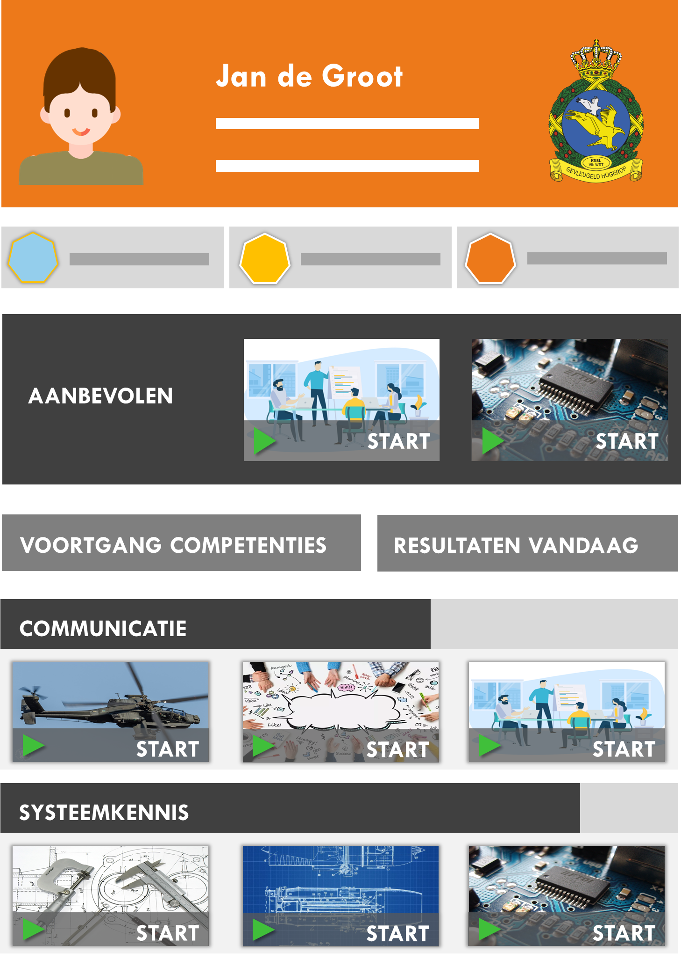

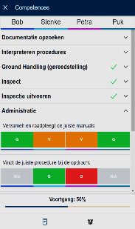
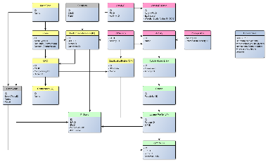
Pre-flight game
Learning eXperience Platform
Janie de Groot
Recommendations
Observation app
Recommender algorithm
Notes:
2 demonstrators are built for logging objective and subjective learning data

Slide 8
Observation Application
Demonstrator

Slide 9


Responsive Design
Separated in time
Observe
Record
Classify
Assess
Observe with structure of competencies – performance indicators (PI)
Timeline
Observe remarkable events (+/-)
Scoring of PIs
Features
Place comments
Scoring Systems (variants)
Record events
Match event with competency
From PI scores to advisory scores for competencies
Provisional grade sheet
PI score
Competency score
Comments
Timeline
Recording complexity factors and ATA-parts
Learning Conversation
Root cause analysis
Update grade sheet
Competency Framework & Qualification Profile
Training Infrastructure
PeopleSoft
Training Design
Learning Task
Planning & Scheduling

Slide 10
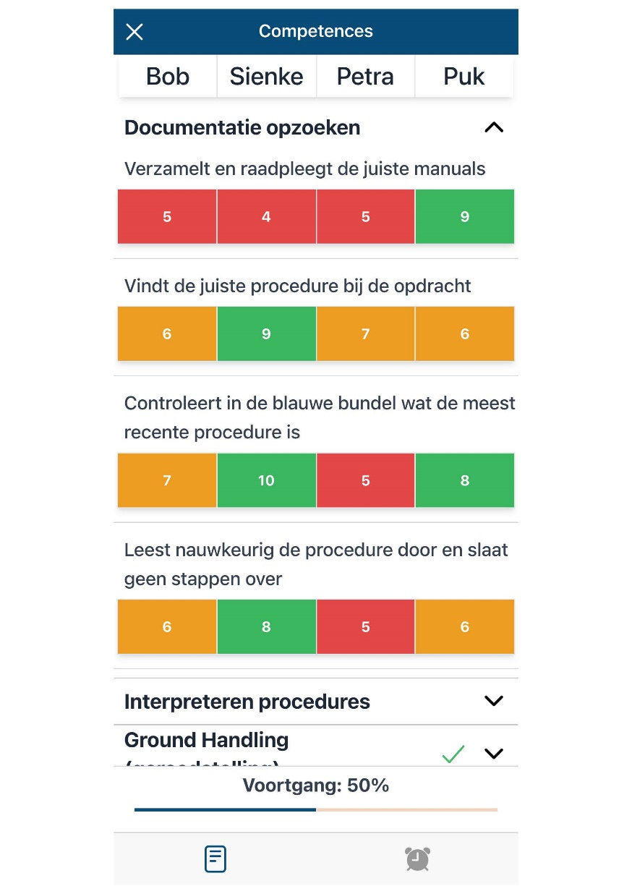
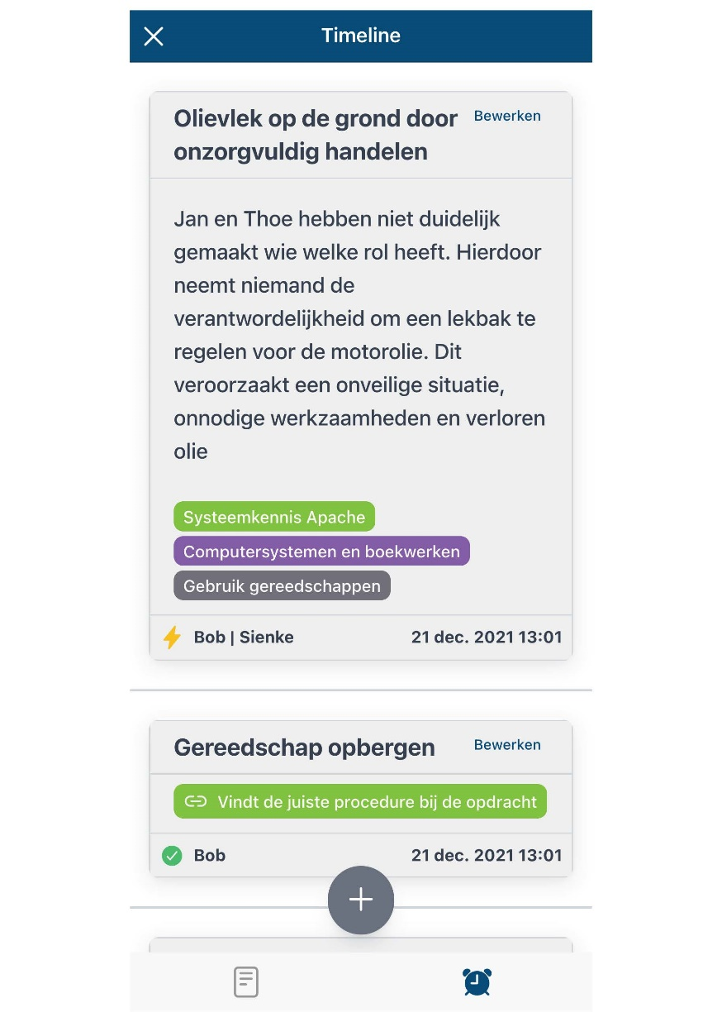

Slide 11
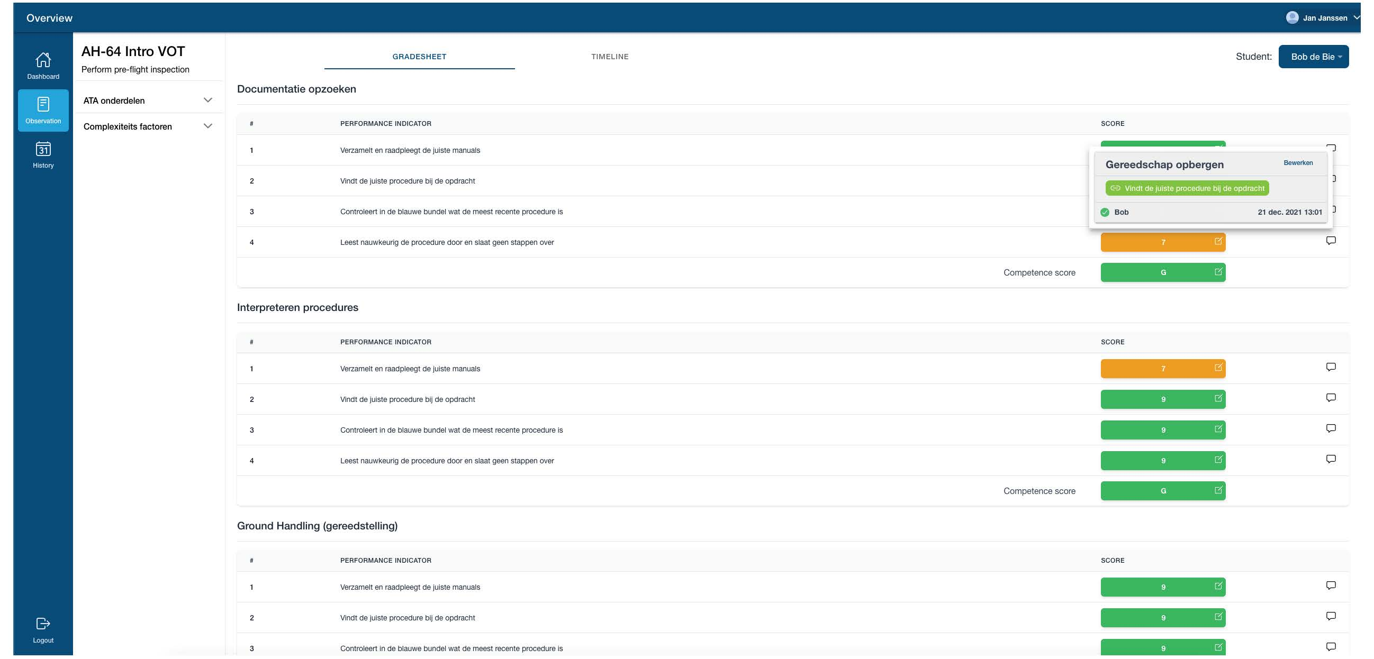

Slide 12
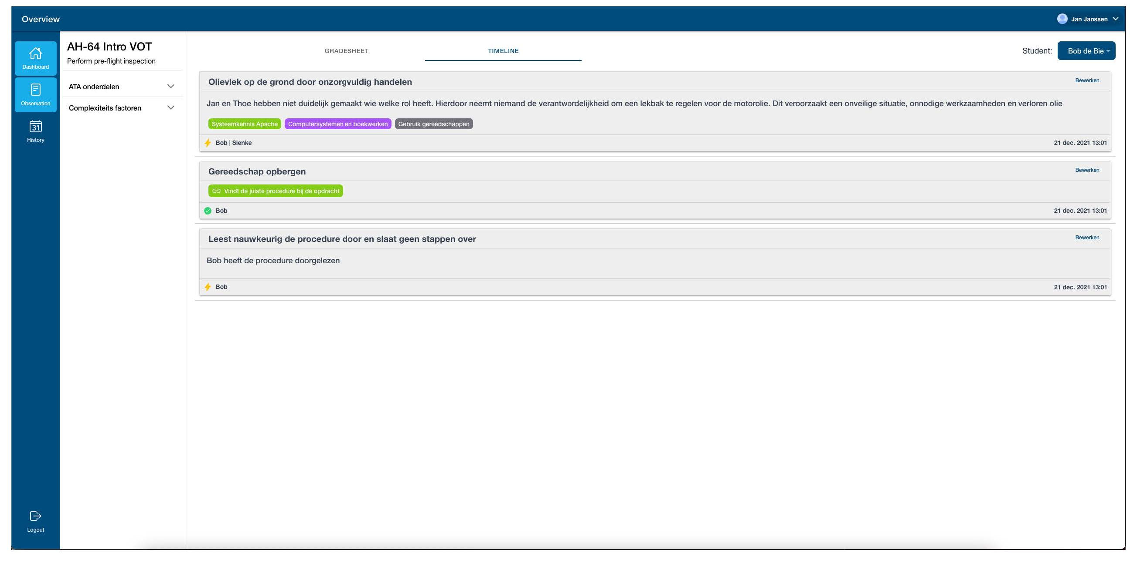

Slide 13
Progressive Scoring System & Recommender

Slide 14
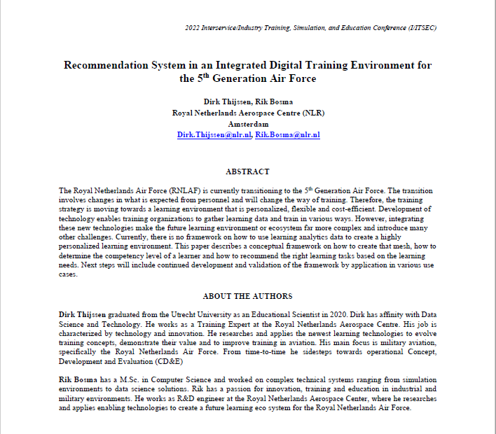
Progressive Scoring System & Recommender
  Research Questions
  How to recommend the best next learning activity to a learner?
  What do we need to do so?
  See I/ITSEC paper for the exact formulas
Presentation at I/ITSEC
Thursday December 1st
8:30-9:00 AM (EST)
W308A

Slide 15
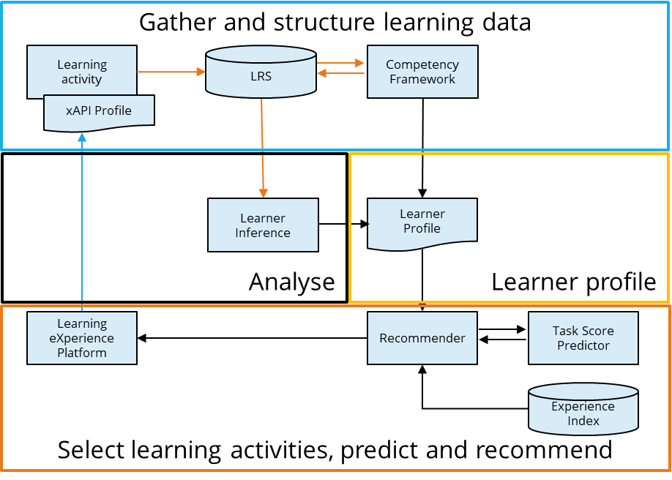
Quantify learner’s proficiency and progression: Progressive Scoring System
Method to select a fitting learning activity: Recommender Algorithm

Slide 16
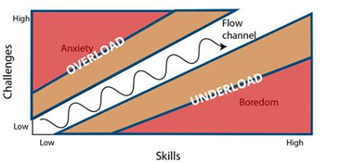
Educational Principles
Let technology behave in a way that suits human’s learning?!
Competency development (Stafford, 2019)
Flow of learning (Csikszentmihalyi, 1990)
Zone of proximal development (Vygotsky,
1978; Wertsch, 1984)
Figure 1. The flow of learning (Czikzentmihalyi, 1990)

Slide 17
Progressive Scoring System
ELO Rating System
Competency framework
Create a mesh of data
Create a mesh: what should a learning activity put out to create a Learner Profile?
ELO rating system: as inspiration to quantify proficiency and progression
Competency framework: structure of the Learner Profile

Slide 18
Progressive Scoring System – ELO Rating System
Proficiency learner per competency expressed in a continuous number | 900
Difficulty learning task per competency expressed in a continuous number | 800
Expected win chance | 0.64 (64%)
Result between 0 and 1 | 0.75
New proficiency level | 912

Slide 19
Progressive Scoring System – ELO Rating System

Slide 20
Progressive Scoring System – Create a mesh
Periodic & ordinal grades converted to a continuous score
Learning Activity output (in xAPI)
  Competency Weight (prior)
  Difficulty (prior)
  Score per competency (outcome)
Create an Experience Index
  Difficulty Level when relevant
  (W ≥ 0.5)
 |  | Competencies
 |  | Safety Awareness | Remove & Install | Accuracy
Learning Task A | W | 0.5 | 0.3 | 0.2
 | D | 600
Learning Task B | W | 0.0 | 0.2 | 1.0
 | D |  |  | 1000
Learning Task C | W | 0.9 | 0.1 | 0.6
 | D | 1500 |  | 1600

Slide 21
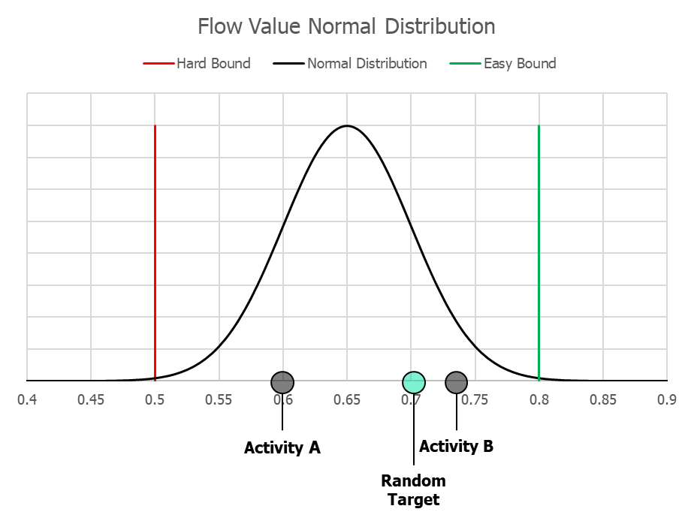
Recommender System
A Learning Profile to display the training need
  Search for competencies that are lacking behind
Select suiting activities: based on win rate
  Flow of learning: keeps you engaged (± 60 – 80%)
  Proximal development: challenging (± 50 – 60%)

Slide 22
Recommender System
Randomly selected a desired win rate
Calculating fit to the win rate per activity over multiple competencies
Recommending activity / activities
A correction of flow occurs when ...
  ... Failing an activity with high expected win rate (ease flow)
  ... Nailing an activity with low expected win rate (hamper flow)

Slide 23
Future Development
ELO Rating System
Competency framework
Create a mesh of data
The dynamics and algorithms are yet to be validated (e.g. flow range, constants)
  Next steps are use cases to do so
Expansion of the model with self-efficacy & skill retention
Methodical approach to fill the Experience Index (difficulty, relevance)

Slide 24
Future work

Slide 25
Gather and structure learning data
Learning activity
Noisy LRS
TLA MOM Filter
Transactional LRS
Competency Framework
Authoritative LRS
xAPI Profile
Analyze
Learner profile
Learning Analytics Store
Learner Analytics
Learner Inference
Learner
Profile
Select and recommend learning activities
Experience Index
Recommender
Task Score Predictor
Learning eXperience Platform

Slide 26
Future work
Learning activity
Noisy LRS
TLA MOM Filter
Transactional LRS
Competency Framework
Authoritative LRS
xAPI Profile
We’d love your ideas, thoughts and feedback!
Translate NL MOD Qualification profiles to Sharable Competency Definitions
Develop Simulation xAPI Toolkit
Convert noisy learning data into TLA MOM

Slide 27
Future work
Learner
Profile
Understand the Learner Profile better
Dealing with European Privacy Law (GDPR)
Learning eXperience Platform
Visualize learning analytics information
Visualize learner profile

Slide 28


Future work
Progressive scoring system
Develop proof of concept
Improve algorithms
Integrate with TLA
Join us on I/ITSEC
@NLR BOOTH
Presentation
Thursday 1 December
8:30-9:00 AM
W308A

Slide 29
Lessons Learned

Slide 30

© vectorpouch
1) Focus on how to support the learner to do his job
Notes:
<a href="https://www.freepik.com/free-photos-vectors/technology">Technology vector created by vectorpouch - www.freepik.com</a>

Slide 31
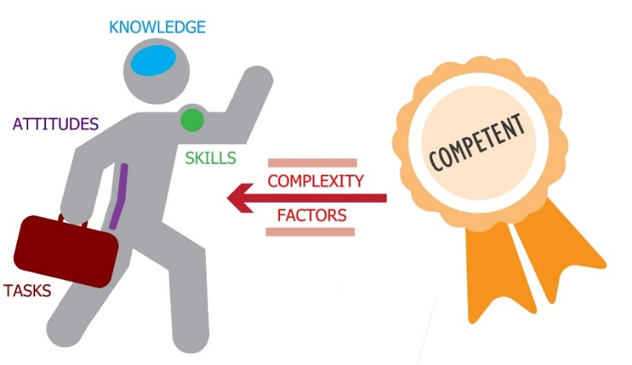
xAPI statement
OBJECT
PERFORMANCE INDICATOR
RESULT
VERB / ACTION
CONTEXT
WHO
2) Find out which data are relevant for the function
(performance indicators, competency framework and complexity factors)
Notes:
Welke data is relevant:
Live data of predictive data
Achteraf kan je weinig doen, enkel gebruik als feedback.

Slide 32

Source: Freepik
3) Closed defence systems vs cloud based solutions = challenging
Notes:
Maak gebruik van plugins
No one tool for everything

Slide 33

4) Clean and big data is needed for algorithms and automated systems, but not available for all professions
Notes:
Welke data is relevant:
Live data of predictive data
Achteraf kan je weinig doen, enkel gebruik als feedback.

Slide 34
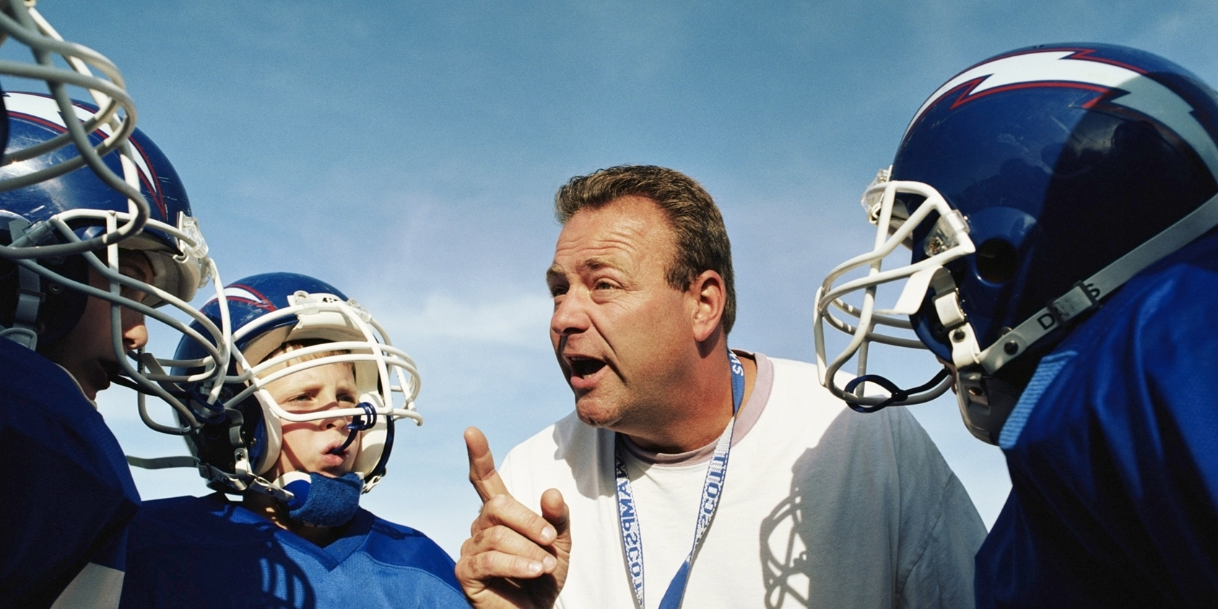
© marcovector
5) Keep the human in the loop
Notes:
<a href="https://www.freepik.com/free-photos-vectors/background">Background vector created by macrovector - www.freepik.com</a>

Slide 35



Notes:
Questions?
Source pictures: most pictures are developed in the IDTEAM project, others come from the website: freepik.com

Slide 36
Petra ten Hove
Training Expert
Aerospace Operations
p ) +31 6 1522 1261
e ) petra.ten.hove@nlr.nl
Rik Bosma MSc.
Lead R&D Engineer
Aerospace Operations
p ) +31 88 511 3708
e ) rik.bosma@nlr.nl
Dirk Thijssen MSc.
Training Technology Expert
Aerospace Operations
p ) +31 88 511 3497
e ) dirk.thijssen@nlr.nl
Notes:
Photo credits: NLR 2019
Eindsheets: 4 t/m 6 kies hieruit één afsluitende sheet.
Ruimtevaart eindslide

